Slide 1


City of Dallas Capstone Presentation
Ruixue Wu
Emily Fogg
Hannah Roark

Slide 2
Agenda
Executive Summary
Business Questions
Analysis Process
Tableau visual walk-through
Data Insights
Project Challenges
Next steps

Slide 3
Executive Summary
Data: 2009 – 2019 Water Quality data on Bachman Branch – Elm Fork Trinity River and Headwaters Turtle Creek
Goals:
Enhance public transparency and promote systematic data analysis with user-friendly visuals built in Tableau
Provide statistical calculations in R
Create a product to guide the City on where and how to focus efforts
Suggest steps for efficient data collection, cleaning, and visualizing for the 30 remaining watersheds

Slide 4
Business Questions
What trends can be identified over the past decade?
How can data be visualized geospatially to show current performance?
How do pollutant levels differ between watersheds?
Can the data be used to create an overall water quality score for each watershed in each year?
How can analysis be made more efficient to enable scalability for all remaining watersheds?
What are the logical next steps for moving forward with water quality data analysis?

Slide 5
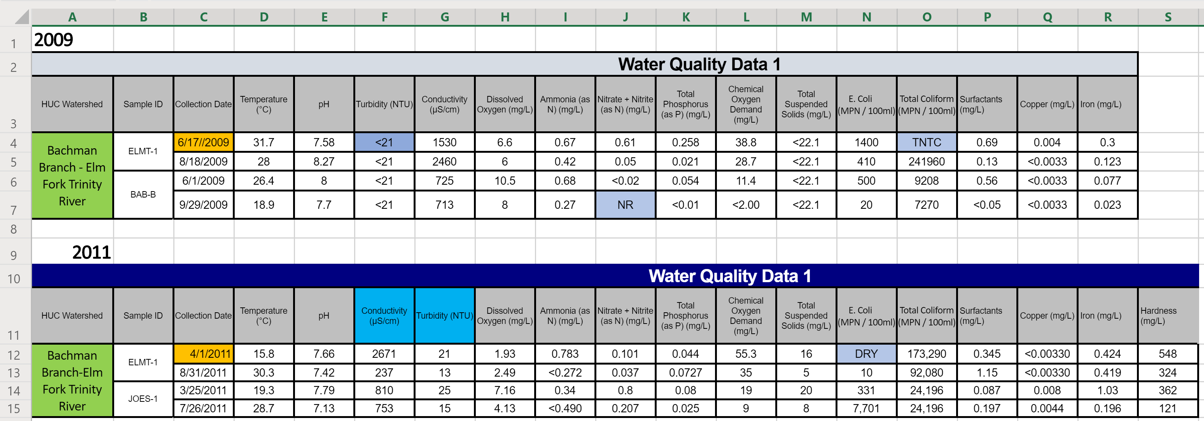
Analysis Tools
Extra slashes and leading spaces
< or > Signs and Text
Inconsistent spacing surrounding the dash
Inconsistent Column Headers
Format data cohesively in Excel
Import Excel files to R and clean the data
Import clean data to Tableau for visualization

Slide 6
Visuals
Now we will walk through the visuals we have built in Tableau

Slide 7
Data Insights
Nitrates, Conductivity, and E. Coli have the most outliers in Headwaters Turtle Creek, and E. Coli and Conductivity have the most outliers for the Bachman Branch.
When looking at the composite score, it seems that Bachman Branch scores higher than Headwaters Turtle Creek for most years.
The ELMT-1 and DAN-A sampling sites in the Bachman Branch watershed and the DAEB-1 and CBD-2 sampling sites in the Headwaters Turtle Creek watershed seem to have the most outliers.
The pollutant with the most extreme outliers by far for both watersheds is E. Coli.

Slide 8
Challenges During Project
Lengthy data cleaning process
Ensuring scalability and usefulness moving forward
Finding relationships with only two watersheds
Getting data into a format that is feasible for use in Tableau
Being unfamiliar with the pollutants and how they interact with each other

Slide 9
Business Recommendations
Data governance & stewardship
Adding all 32 watersheds to analysis
Revisit acceptable parameters
Think about where and how often samples are collected
Set thresholds to trigger further investigation
Real-time telemetry data captured via sensors and uploaded into the Cloud. Processed data imported to Tableau and R in batches

